Slide 1

A* Wrap Up
Read AIMA 3.1-3.6.
Some materials will not
be covered in lecture, but
will be on the exam.

Slide 2



Review: Shape of Search
Breadth First Search explores equally in all directions. It’s frontier is implemented as a FIFO queue. It is applicable to unweighted graphs.
Uniform Cost Search lets us prioritize which paths to explore. Instead of exploring all possible paths equally, it favors lower cost paths. It’s frontier is a priority queue.
A* prioritizes paths that seem to be leading towards the goal. It uses a priority queue sorted based on a combination of path cost plus a heuristic cost to the goal.
Notes:
Shapes from https://www.redblobgames.com/pathfinding/a-star/introduction.html

Slide 3
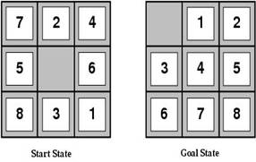
Review: Heuristic functions
For the 8-puzzle
Avg. solution cost is about 22 steps
(branching factor ≤ 3)
Exhaustive search to depth 22: 3.1 x 10¹⁰ states
A good heuristic function can reduce the search process
Notes:
Exhaustive search like BFS

Slide 4


Review: Admissibility
Inadmissible (pessimistic) heuristics break optimality by trapping good plans on the fringe
Admissible (optimistic) heuristics slow down bad plans but never outweigh true costs
Slide credit: Dan Klein and Pieter Abbeel
http://ai.berkeley.edu
Notes:
Optimistic must be true of every state in your state space. If any state is an not optimistic estimate, then heuristic is inadmissible.

Slide 5



Review: Admissible Heuristics
A heuristic h is admissible (optimistic) if:
where is the true cost to a nearest goal
Is Manhattan Distance admissible?
Coming up with admissible heuristics is most of what’s involved in using A* in practice.
Notes:
h*(n) is the cheapest way of reaching your goal.
h(n) must be positive.
Yes, Manhattan Distance is admissible. Ask students why?

Slide 6

Optimality of A* Tree Search
Slide credit: Dan Klein and Pieter Abbeel
http://ai.berkeley.edu

Slide 7


Optimality of A* Tree Search
Assume:
A is an optimal goal node
B is a suboptimal goal node
h is admissible
Claim:
A will exit the fringe before B
…
Slide credit: Dan Klein and Pieter Abbeel
http://ai.berkeley.edu
Notes:
Claim we will prove first. If we can prove this then we know we’ve found an optimal path to the goal.

Slide 8



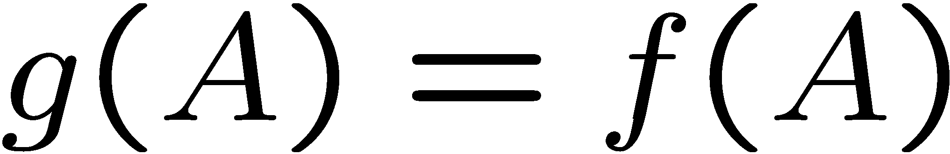
Optimality of A* Tree Search: Blocking
Proof:
Imagine B is on the fringe
Some ancestor n of A is on the fringe, too (maybe A!)
Claim: n will be expanded before B
f(n) is less or equal to f(A)
…
Definition of f-cost
Admissibility of h
h = 0 at a goal
Slide credit: Dan Klein and Pieter Abbeel
http://ai.berkeley.edu
Notes:
We always have some ancestor of A, since we will either have the root, or some child that expands from it and leads to A. (It could be A itself)

Slide 9


Optimality of A* Tree Search: Blocking
Proof:
Imagine B is on the fringe
Some ancestor n of A is on the fringe, too (maybe A!)
Claim: n will be expanded before B
f(n) is less or equal to f(A)
f(A) is less than f(B)
…
B is suboptimal
h = 0 at a goal
Slide credit: Dan Klein and Pieter Abbeel
http://ai.berkeley.edu

Slide 10

Optimality of A* Tree Search: Blocking
Proof:
Imagine B is on the fringe
Some ancestor n of A is on the fringe, too (maybe A!)
Claim: n will be expanded before B
f(n) is less or equal to f(A)
f(A) is less than f(B)
n expands before B
All ancestors of A expand before B
A expands before B
A* search is optimal
…
Slide credit: Dan Klein and Pieter Abbeel
http://ai.berkeley.edu

Slide 11
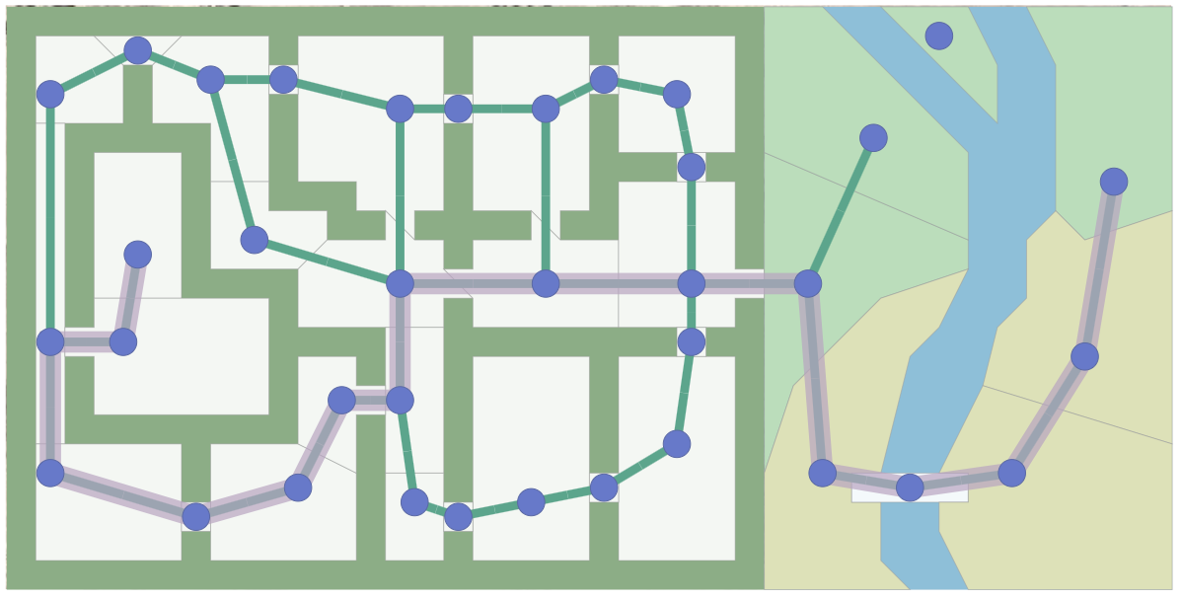
A* Applications
Pathing / routing problems (A* is in your GPS!)
Video games
Robot motion planning
Resource planning problems
…
Notes:
A lot of games where you have to move troops around using A*

Slide 12
Constraint Satisfaction Problems
AIMA: Chapter 6

Slide 13
What is Search For?
Assumptions about the world: a single agent, deterministic actions, fully observed state, discrete state space
Planning: sequences of actions
The path to the goal is the important thing
Paths have various costs, depths
Heuristics give problem-specific guidance
Identification: assignments to variables
The goal itself is important, not the path
All paths at the same depth (for some formulations)
CSPs are specialized for identification problems

Slide 14
Big idea
Represent the constraints that solutions must satisfy in a uniform declarative language
Find solutions by GENERAL PURPOSE search algorithms with no changes from problem to problem
No hand built transition functions
No hand built heuristics
Just specify the problem in a formal declarative language, and a general purpose algorithm does everything else!

Slide 15
Constraint Satisfaction Problems
A CSP consists of:
Finite set of variables X₁, X₂, …, X_{n}
Nonempty domain of possible values for each variable D₁, D₂, … D_{n} where D_{i} = {v₁, …, v_{k}}
Finite set of constraints C₁, C₂, …, C_{m}
Each constraint C_{i} limits the values that variables can take, e.g., X₁ ≠ X₂ A state is defined as an assignment of values to some or all variables.
A consistent assignment does not violate the constraints.
Example problem: Sudoku

Slide 16
Constraint satisfaction problems
An assignment is complete when every variable is assigned a value.
A solution to a CSP is a complete, consistent assignment.
Solutions to CSPs can be found by a completely general purpose algorithm, given only the formal specification of the CSP.
Beyond our scope: CSPs that require a solution that maximizes an objective function.

Slide 17
Applications
Map coloring
Scheduling problems
Job shop scheduling
Scheduling the Hubble Space Telescope
Floor planning for VLSI
Sudoku
…
Notes:
VLSI Very-large-scale integration is the process of creating an integrated circuit (IC) by combining thousands of transistors into a single chip.

Slide 18
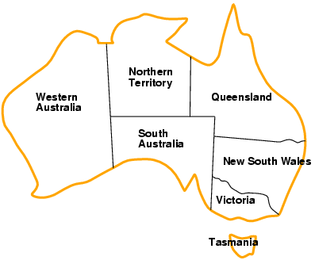
Example: Map-coloring
Variables: WA, NT, Q, NSW, V, SA, T
Domains: D_{i} = {red,green,blue}
Constraints: adjacent regions must have different colors
e.g., WA ≠ NT
So (WA,NT) must be in {(red,green),(red,blue),(green,red), …}

Slide 19
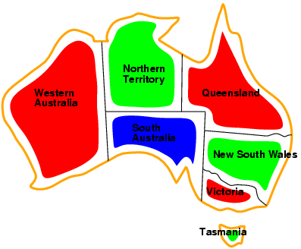
Example: Map-coloring
Solutions: complete and consistent assignments
e.g., WA = red, NT = green,Q = red, NSW = green, V = red, SA = blue, T = green
Notes:
Famous question: can any map be colored in with four colors?

Slide 20
Benefits of CSP
Clean specification of many problems, generic goal, successor function & heuristics
Just represent problem as a CSP & solve with general package
CSP “knows” which variables violate a constraint
And hence where to focus the search
CSPs: Automatically prune off all branches that violate constraints
(State space search could do this only by hand-building constraints into the successor function)

Slide 21
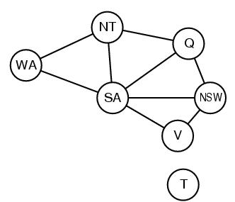
CSP Representations
Constraint graph:
nodes are variables
arcs are (binary) constraints
Standard representation pattern:
variables with values
Constraint graph simplifies search.
e.g. Tasmania is an independent subproblem.
This problem: A binary CSP:
each constraint relates two variables
WA ≠ NT
NT ≠ Q
NT ≠ SA
WA ≠ SA

Slide 22
Varieties of CSPs
Discrete variables
finite domains:
n variables, domain size d → O(d^{n}) complete assignments
e.g., Boolean CSPs, includes Boolean satisfiability (NP-complete)
infinite domains:
integers, strings, etc.
e.g., job scheduling, variables are start/end days for each job
need a constraint language, e.g., StartJob₁ + 5 ≤ StartJob₃
Continuous variables
e.g., start/end times for Hubble Space Telescope observations
linear constraints solvable in polynomial time by linear programming

Slide 23
Varieties of constraints
Unary constraints involve a single variable,
e.g., SA ≠ green
Binary constraints involve pairs of variables,
e.g., SA ≠ WA
Higher-order constraints involve 3 or more variables
e.g., crypt-arithmetic column constraints
Preference (soft constraints) e.g. red is better than green can be represented by a cost for each variable assignment
Constrained optimization problems.

Slide 24
Idea 1: CSP as a search problem
A CSP can easily be expressed as a search problem
Initial State: the empty assignment {}.
Successor function: Assign value to any unassigned variable provided that there is not a constraint conflict.
Goal test: the current assignment is complete.
Path cost: a constant cost for every step.
Solution is always found at depth n, for n variables
Hence Depth First Search can be used

Slide 25
Search and branching factor
…
n variables of domain size d
Branching factor at the root is n*d
Branching factor at next level is (n-1)*d
Tree has n!*d^{n} leaves

Slide 26
Search and branching factor
The variable assignments are commutative
Eg [ step 1: WA = red; step 2: NT = green ] equivalent to [ step 1: NT = green; step 2: WA = red ]
Therefore, a tree search, not a graph search
Only need to consider assignments to a single variable at each node
b = d and there are d^{n} leaves (n variables, domain size d )
Notes:
A problem is commutative if the order of application of any given set of actions has no effect on the outcome. CSPs are commutative because when assigning values to variables, we reach the same partial assignment regardless of order. Therefore, we need only consider a single variable at each node in the search tree. For example, at the root node of a search tree for coloring the map of Australia, we might make a choice between SA = red, SA = green, and SA = blue, but we would never choose between SA = red and WA = blue.
The term backtracking search is used for a depth-first search that chooses values for one variable at a time and backtracks when a variable has no legal values left to assign.

Slide 27
Search and Backtracking
Depth-first search for CSPs with single-variable assignments is called backtracking search
The term backtracking search is used for a depth-first search that chooses values for one variable at a time and backtracks when a variable has no legal values left to assign.
Backtracking search is the basic uninformed algorithm for CSPs
Notes:
A problem is commutative if the order of application of any given set of actions has no effect on the outcome. CSPs are commutative because when assigning values to variables, we reach the same partial assignment regardless of order. Therefore, we need only consider a single variable at each node in the search tree. For example, at the root node of a search tree for coloring the map of Australia, we might make a choice between SA = red, SA = green, and SA = blue, but we would never choose between SA = red and WA = blue.
The term backtracking search is used for a depth-first search that chooses values for one variable at a time and backtracks when a variable has no legal values left to assign.

Slide 28
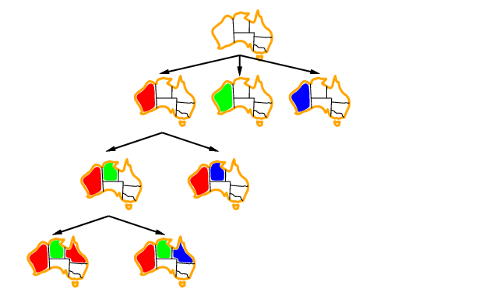
Backtracking example
Notes:
The term backtracking search is used for a depth-first search that chooses values for one variable at a time and backtracks when a variable has no legal values left to assign.
Which variable should be assigned next (SELECT-UNASSIGNED-VARIABLE), and in what order should its values be tried (ORDER-DOMAIN-VALUES)?
What inferences should be performed at each step in the search (INFERENCE)?
When the search arrives at an assignment that violates a constraint, can the search avoid repeating this failure?

Slide 29
Backtracking example
And so on….
Notes:
The term backtracking search is used for a depth-first search that chooses values for one variable at a time and backtracks when a variable has no legal values left to assign.
one variable at a time and backtracks when a variable has no legal values left to assign.

Slide 30
Idea 2: Improving backtracking efficiency
General-purpose methods & general-purpose heuristics can give huge gains in speed, on average
Heuristics:
Q: Which variable should be assigned next?
Most constrained variable
(if ties:) Most constraining variable
Q: In what order should that variable’s values be tried?
3. Least constraining value
Q: Can we detect inevitable failure early? 4. Forward checking

Slide 31

Heuristic 1: Most constrained variable
Choose a variable with the fewest legal values
a.k.a. minimum remaining values (MRV) heuristic
3
3
2
3
1
3
2
3
2
1
3
3
3
2
3
3
3
3
3
3
3
3

Slide 32

Heuristic 2: Most constraining variable
Tie-breaker among most constrained variables
Choose the variable with the most constraints on remaining variables
These two heuristics together lead to immediate solution of our example problem

Slide 33
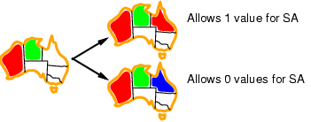
Heuristic 3: Least constraining value
Given a variable, choose the least constraining value:
the one that rules out the fewest values in the remaining variables
Note: demonstrated here independent of the other heuristics

Slide 34
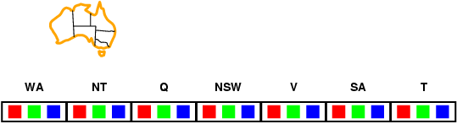
Heuristic 4: Forward checking
Idea:
Keep track of remaining legal values for unassigned variables
Terminate search when any unassigned variable has no remaining legal values
(A first step towards Arc Consistency & AC-3)
New data structure

Slide 35
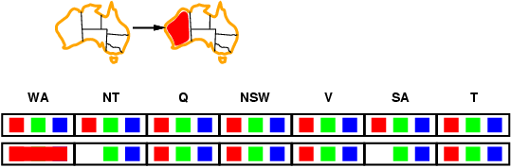
Forward checking
Idea:
Keep track of remaining legal values for unassigned variables
Terminate search when any unassigned variable has no remaining legal values

Slide 36
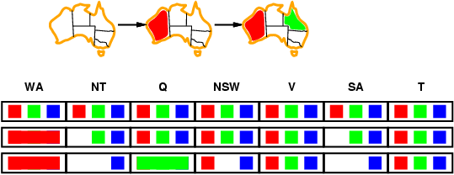

Forward checking
Idea:
Keep track of remaining legal values for unassigned variables
Terminate search when any unassigned variable has no remaining legal values

Slide 37
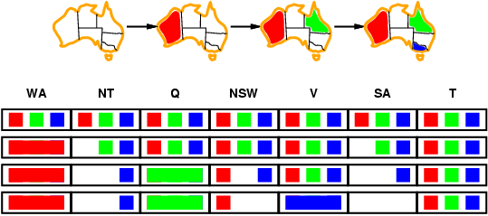
Forward checking
Idea:
Keep track of remaining legal values for unassigned variables
Terminate search when any unassigned variable has no remaining legal values
Terminate! No possible value for SA

Slide 38
Example: 4-Queens Problem
X1
{1,2,3,4}
X2
{1,2,3,4}
1
2
3
4
1
2
3
4
X3
{1,2,3,4}
X4
{1,2,3,4}
Assign value to unassigned variable

Slide 39
Example: 4-Queens Problem
X1
{1,2,3,4}
X2
{ , ,3,4}
1
2
3
4
1
2
3
4
X3
{ ,2, ,4}
X4
{ ,2,3, }
Forward check!

Slide 40
Example: 4-Queens Problem
X1
{1,2,3,4}
X2
{ , ,3,4}
1
2
3
4
1
2
3
4
X3
{ ,2, ,4}
X4
{ ,2,3, }
Assign value to unassigned variable

Slide 41
Example: 4-Queens Problem
X1
{1,2,3,4}
X2
{ , ,3,4}
1
2
3
4
1
2
3
4
X3
{ , , , }
X4
{ ,2, , }
Backtrack!!!
Forward check!

Slide 42
Example: 4-Queens Problem
Picking up a little later after two steps of backtracking….
X1
{ ,2,3,4}
X2
{1,2,3,4}
1
2
3
4
1
2
3
4
X3
{1,2,3,4}
X4
{1,2,3,4}
Assign value to unassigned variable

Slide 43
Example: 4-Queens Problem
X1
{ ,2,3,4}
X2
{ , , ,4}
1
2
3
4
1
2
3
4
X3
{1, ,3, }
X4
{1, ,3,4}
Forward check!

Slide 44
Example: 4-Queens Problem
X1
{ ,2,3,4}
X2
{ , , ,4}
1
2
3
4
1
2
3
4
X3
{1, ,3, }
X4
{1, ,3,4}
Assign value to unassigned variable

Slide 45
Example: 4-Queens Problem
X1
{ ,2,3,4}
X2
{ , , ,4}
1
2
3
4
1
2
3
4
X3
{1, , , }
X4
{1, ,3, }
Forward check!

Slide 46
Example: 4-Queens Problem
X1
{ ,2,3,4}
X2
{ , , ,4}
1
2
3
4
1
2
3
4
X3
{1, , , }
X4
{1, ,3, }
Assign value to unassigned variable

Slide 47
Example: 4-Queens Problem
X1
{ ,2,3,4}
X2
{ , , ,4}
1
2
3
4
1
2
3
4
X3
{1, , , }
X4
{ , ,3, }
Forward check!

Slide 48
Example: 4-Queens Problem
X1
{ ,2,3,4}
X2
{ , , ,4}
1
2
3
4
1
2
3
4
X3
{1, , , }
X4
{ , ,3, }
Assign value to unassigned variable

Slide 49
Towards Constraint propagation
Forward checking propagates information from assigned to unassigned variables, but doesn't provide early detection for all failures:
NT and SA cannot both be blue!
Constraint propagation goes beyond forward checking & repeatedly enforces constraints locally

Slide 50
Arc Consistency, Constraint Propagation & AC-3

Slide 51
Idea 3 (big idea): Inference in CSPs
CSP solvers combine search and inference
Search
assigning a value to a variable
Constraint propagation (inference)
Eliminates possible values for a variable if the value would violate local consistency
Can do inference first, or intertwine it with search
You’ll investigate this in the Sudoku homework
Local consistency
Node consistency: satisfies unary constraints
This is trivial!
Arc consistency: satisfies binary constraints
(X_{i} is arc-consistent w.r.t. X_{j} if for every value v in D_{i}, there is some value w in D_{j} that satisfies the binary constraint on the arc between X_{i} and X_{j})

Slide 52
CSP Representations
Constraint graph:
nodes are variables
edges are constraints
WA ≠ NT
NT ≠ Q
NT ≠ SA
WA ≠ SA

Slide 53
Edges to Arcs: From Constraint Graph to Directed Graph
Given a pair of nodes X_{i} and X_{j} connected by a constraint edge, we represent this not by a single undirected edge, but a pair of directed arcs.
For a connected pair of nodes X_{i} and X_{j} , there are two arcs that connect them: (i,j) and (j,i).
(i,j)
⇒
X_{i}
X_{j}
X_{i}
X_{j}
(j,i)

Slide 54
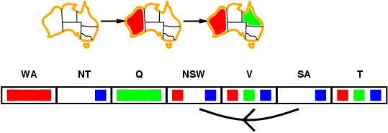
Arc consistency
Simplest form of propagation makes each arc consistent
X →Y is consistent iff for every value x of X there is some allowed y

Slide 55
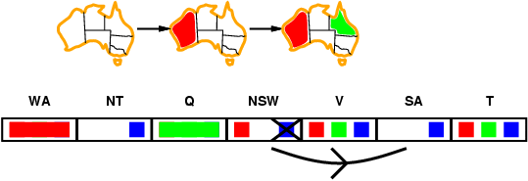
Arc consistency
Simplest form of propagation makes each arc consistent
X →Y is consistent iff for every value x of X there is some allowed y
Notes:
Always throw out things from the tail that are not consistent with the head.

Slide 56
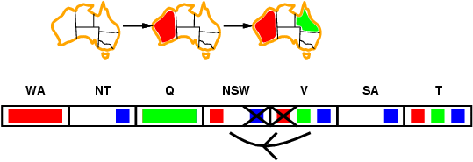
Arc consistency
Simplest form of propagation makes each arc consistent
X →Y is consistent iff for every value x of X there is some allowed y
If X loses a value, recheck neighbors of X

Slide 57
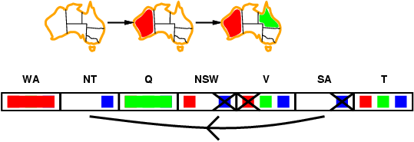
Arc consistency
Simplest form of propagation makes each arc consistent
X →Y is consistent iff for every value x of X there is some allowed y
If X loses a value, we need to recheck neighbors of X
Detects failure earlier than forward checking Can be run as a preprocessor or after each assignment

Slide 58
Arc Consistency
An arc (i,j) is arc consistent if and only if every value v on X_{i} is consistent with some label on Y_{j}.
To make an arc (i,j) arc consistent, for each value v on X_{i} , if there is no label on Y_{j} consistent with v
then remove v from X_{i}
Given d values, checking arc (i,j) takes O(d²) time worst case

Slide 59
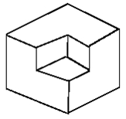

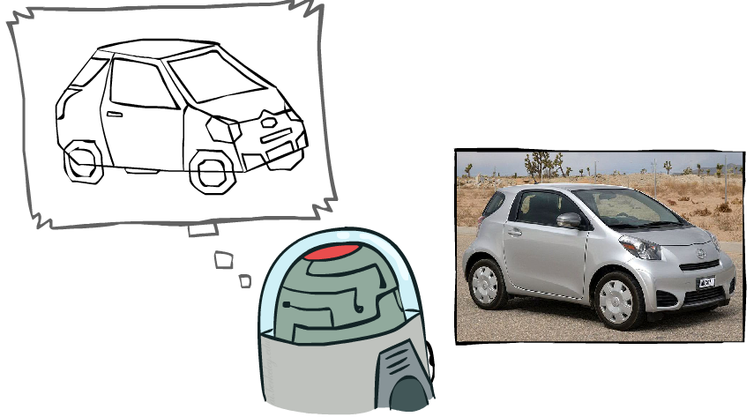
Example: The Waltz Algorithm
The Waltz algorithm is for interpreting line drawings of solid polyhedra as 3D objects
An early example of an AI computation posed as a CSP
?
Approach:
Each intersection is a variable
Adjacent intersections impose constraints on each other
Solutions are physically realizable 3D interpretations
Slide credit: Dan Klein and Pieter Abbeel
http://ai.berkeley.edu

Slide 60

Replacing Search: Constraint Propagation Invented…
Dave Waltz’s insight:
By iterating over the graph, the arc-consistency constraints can be propagated along arcs of the graph.
Search: Use constraints to add labels to find one solution
Constraint Propagation: Use constraints to eliminate labels to simultaneously find all solutions

Slide 61
The Waltz/Mackworth Constraint Propagation Algorithm
Assign every node in the constraint graph a set of all possible values
Repeat until there is no change in the set of values associated with any node:
For each node i:
For each neighboring node j in the picture:
Remove any value from i which is not arc consistent with j.

Slide 62
Inefficiencies: Towards AC-3
At each iteration, we only need to examine those X_{i} where at least one neighbor of X_{i} has lost a value in the previous iteration.
If X_{i} loses a value only because of arc inconsistencies with Y_{j}, we don’t need to check X_{j} on the next iteration.
Removing a value on X_{i} can only make Y_{j} arc-inconsistent with respect to X_{i} itself. Thus, we only need to check that (j,i) is still arc-consistent.
These insights lead a much better algorithm...

Slide 63
AC-3
function AC-3(csp) return the CSP, possibly with reduced domains
inputs: csp, a binary csp with variables {X₁, X₂, …, X_{n}}
local variables: queue, a queue of arcs initially the arcs in csp
while queue is not empty do
(X_{i}, X_{j}) ← REMOVE-FIRST(queue)
if REMOVE-INCONSISTENT-VALUES(X_{i}, X_{j}) then
for each X_{k} in NEIGHBORS[X_{i} ] – {X_{j}} do add (X_{k}, X_{i}) to queue
function REMOVE-INCONSISTENT-VALUES(X_{i}, X_{j}) return true iff we remove a value
removed ← false
for each x in DOMAIN[X_{i}] do
if no value y in DOMAIN[X_{j}] allows (x,y) to satisfy the constraints between X_{i} and X_{j}
then delete x from DOMAIN[X_{i}]; removed ← true
return removed
Notes:
Queue is actually a set

Slide 64
AC-3: Worst Case Complexity Analysis
All nodes can be connected to every other node,
so each of n nodes must be compared against n-1 other nodes,
so total # of arcs is 2*n*(n-1), i.e. O(n²)
If there are d values, checking arc (i,j) takes O(d²) time
Each arc (i,j) can only be inserted into the queue d times
Worst case complexity: O(n²d³)
(For planar constraint graphs, the number of arcs can only be linear in N and the time complexity is only O(nd³))
Notes:
This is the worst case time complexity, and only happens in a complete graph where all nodes are fully connected.
Planar graph is one with no edges that are crossing.

Slide 65
CSPs and Search
Assumptions about the world: a single agent, deterministic actions, fully observed state, discrete state space
Planning: sequences of actions
The path to the goal is the important thing
Paths have various costs, depths
Heuristics give problem-specific guidance
Identification: assignments to variables
The goal itself is important, not the path
All paths at the same depth (for some formulations)
CSPs are specialized for identification problems

Slide 66
Local search for CSPs
Hill-climbing, simulated annealing typically work with "complete" states, i.e., all variables assigned
To apply to CSPs:
allow states with unsatisfied constraints
operators reassign variable values
Variable selection: randomly select any conflicted variable
Value selection by min-conflicts heuristic:
choose value that violates the fewest constraints
i.e., hill-climb with h(n) = total number of violated constraints

Slide 67
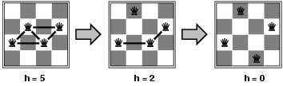
Example: n-queens
States: 4 queens in 4 columns (4⁴ = 256 states)
Actions: move queen in column
Goal test: no attacks
Evaluation: h(n) = number of attacks
Given random initial state, local min-conflicts can solve n-queens in almost constant time for arbitrary n with high probability (e.g., n = 10,000,000)

Slide 68
Beyond binary constraints: Path consistency
Generalizes arc-consistency from individual binary constraints to multiple constraints
A pair of variables X_{i}, X_{j} is path-consistent w.r.t. X_{m} if for every assignment X_{i}=a, X_{j}=b consistent with the constraints on X_{i}, X_{j} there is an assignment to X_{m} that satisfied the constraints on X_{i}, X_{m} and X_{j}, X_{m}
Global constraints
Can apply to any number of variables
E.g., in Sudoko, all numbers in a row must be different
E.g., in cryptarithmetic, each letter must be a different digit
Example algorithm:
If any variable has a single possible value, delete that variable from the domains of all other constrained variables
If no values are left for any variable, you found a contradiction

Slide 69
Simple CSPs can be solved quickly
Completely independent subproblems
e.g. Australia & Tasmania
Easiest
Constraint graph is a tree
Any two variables are connected by only a single path
Permits solution in time linear in number of variables
Do a topological sort and just march down the list
A E
\ /
B – D A ➔ B ➔ C ➔ D ➔E ➔ F
/ \
C F

Slide 70
Simplifying hard CSPs: Cycle Cutsets
Constraint graph can be decomposed into a tree
Collapse or remove nodes
Cycle cutset S of a graph G: any subset of vertices of G that, if removed, leaves G a tree
Cycle cutset algorithm
Choose some cutset S
For each possible assignment to the variables in S that satisfies all constraints on S
Remove any values for the domains of the remaining variables that are not consistent with S
If the remaining CSP has a solution, then you have are done
For graph size n, domain size d
Time complexity for cycle cutset of size c: O(d^{c *} d²(n-c)) = O(d^{c+2} (n-c))

Slide 71
Chronological backtracking
DFS does Chronological backtracking
If a branch of a search fails, backtrack to the most recent variable assignment and try something different
But this variable may not be related to the failure
Example: Map coloring of Australia
Variable order
Q, NSW, V, T, SA, WA, NT.
Current assignment:
Q=red, NWS=green, V=blue, T= red
SA cannot be assigned anything
But reassigning T does not help!

Slide 72
Backjumping: Improved backtracking
Find “the conflict set”
Those variable assignments that are in conflict
Conflict set for SA: {Q=red, NSW=green, V=blue}
Jump back to reassign one of those conflicting variables
Forward checking can build the conflict set
When a value is deleted from a variable’s domain, add it to its conflict set
But backjumping finds the same conflicts that forward checking does
Fix using “conflict-directed backjumping”
Go back to predecessors of conflict set

Slide 73
When to Iterate, When to Stop?
The crucial principle:
If a value is removed from a node X_{i},
then the values on all of X_{i}’s neighbors must be reexamined.
Why? Removing a value from a node may result in one of the neighbors becoming arc inconsistent, so we need to check…
(but each neighbor X_{j} can only become inconsistent with respect to the removed values on X_{i})

